Slide 1


Sports…
BY: RICHA

Slide 2


* TOPICS *
DIFFERENT KINDS OF GAMES
WHAT IS SPORTS ?
ORIGIN OF SPORTS
CLASSIFICATION OF SPORTS
BENEFITS OF SPORTS
GENERAL BENEFITS OF SPORTS
WHAT DO WE (STUDENTS) PLAY ?
WHAT DO WE GAIN FROM SPORTS ?

Slide 3
* WHAT IS SPORTS ? *
An activity involving physical exertion and skill in which an individual or team competes with another or other for entertainment is called sports.
Example of some of the sports that we usually play : Cricket , Basketball , Football , Chess and many other.

Slide 4
* ORIGIN OF SPORTS IN INDIA *
The history of sports in India dates back to the Vedic era .
The Mantra in the Atharvaveda says,“Duty is my right hand and the fruit of victory in my left.” In trm of ideal, these words hold the same sentiments as the traditional Olympics Oath : “For the honour of my Country and the Glory of sports”.
Games like Chess, snake and ladder and playing cards are originated in India.

Slide 5
* DIFFERENT KINDS OF SPORTS *
Indoor game : The game which are played inside a room are known as Indoor game.
Example : Chess, Table tennis, Carrom, etc.
Outdoor game : The game which are played outside such as in grounds are known as outdoor games.
Example : Kabaddi, Kho-kho, Lawn tennis. Basketball, etc.

Slide 6
* CLASSIFICATION OF SPORTS *
*Sports can be classified on the basis of :
Physical sports : An athletic activity requiring skill or physical power and often of a competitive nature are called physical sports.

Slide 7
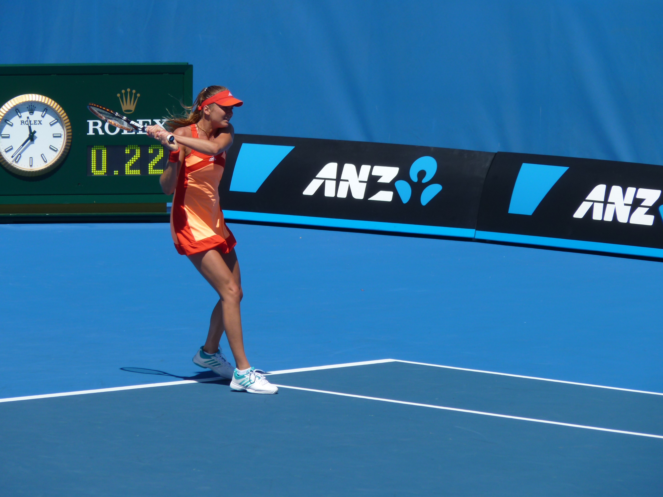

WRESTLING
LAWN TENNIS
This Photo by Unknown Author is licensed under CC BY-SA

Slide 8

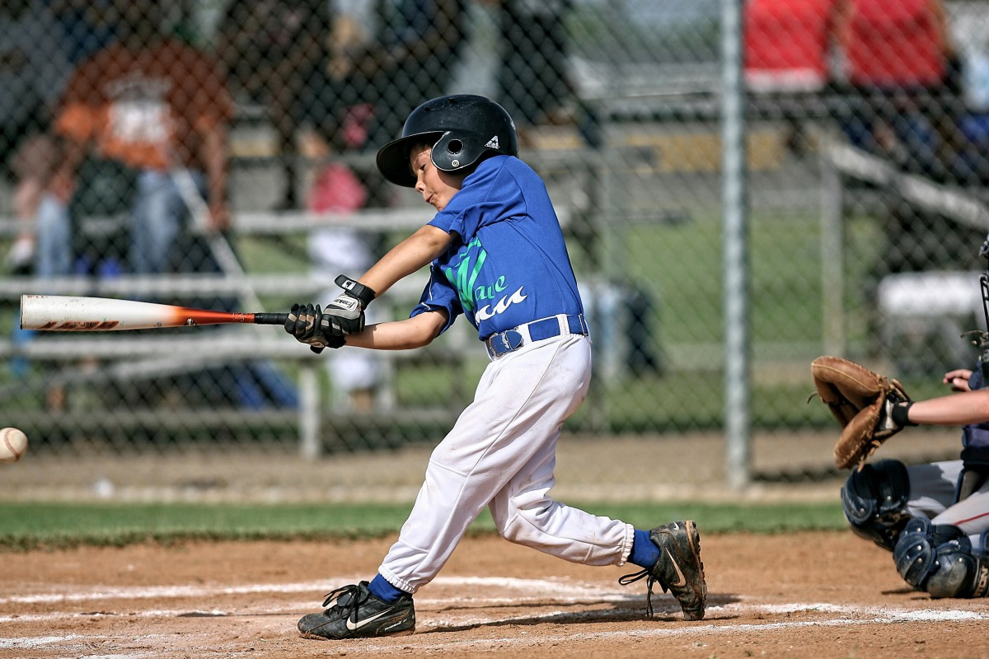
RUNNING
BASEBALL

Slide 9
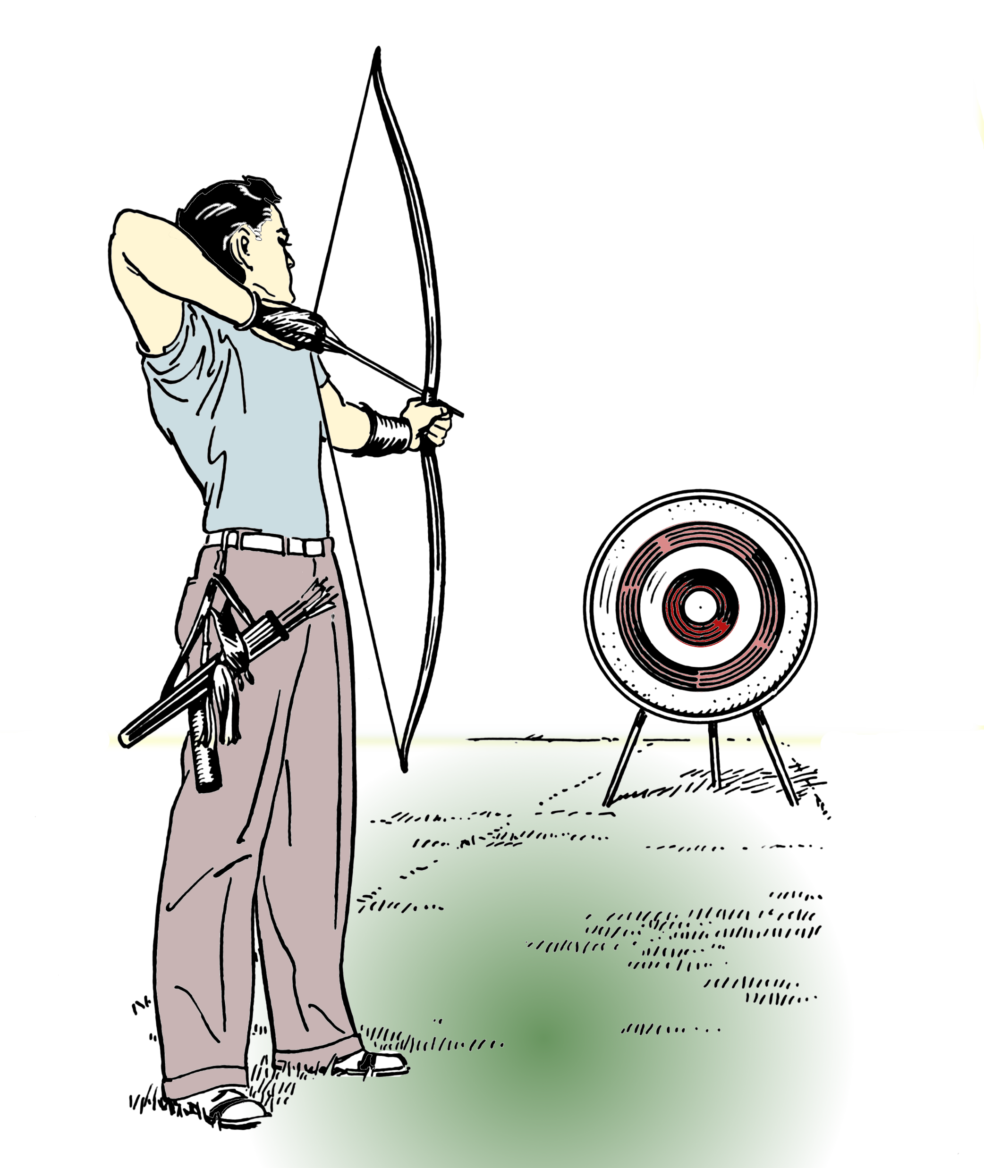
Mental sports : A mind sports is a game of skill where the mental component is more significant than the physical.

Slide 10
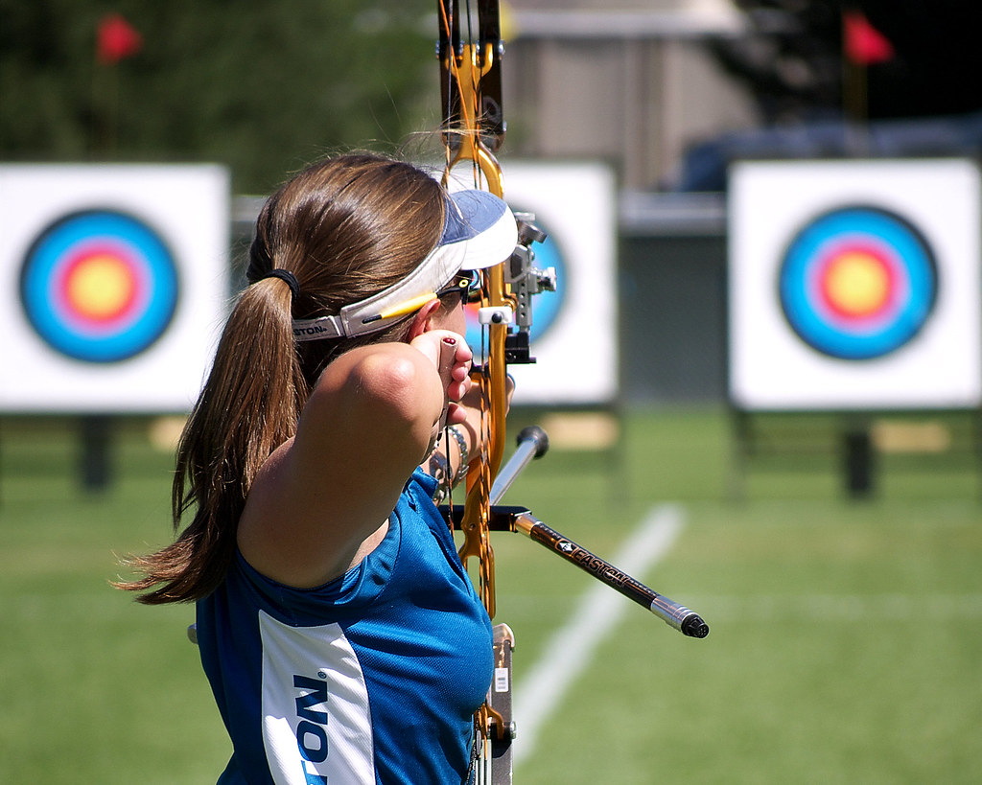

ARCHERY
CHESS

Slide 11

* BENEFITS OF MENTAL SPORTS *
Improves mood
Improve concentration
Sharpens focus
Reduce stress

Slide 12

Social sports : These are the game such as in team games/sports in which we meet more number of people and increase our social network.

Slide 13
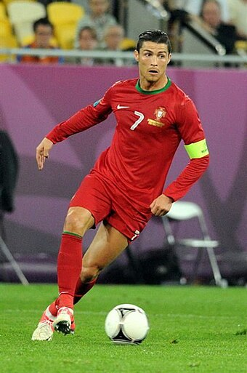
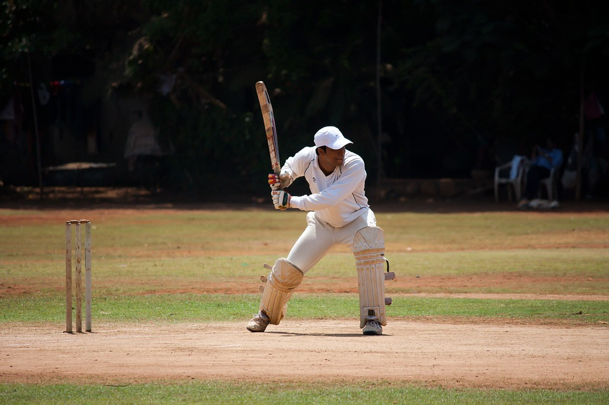
FOOTBALL
CRICKET

Slide 14
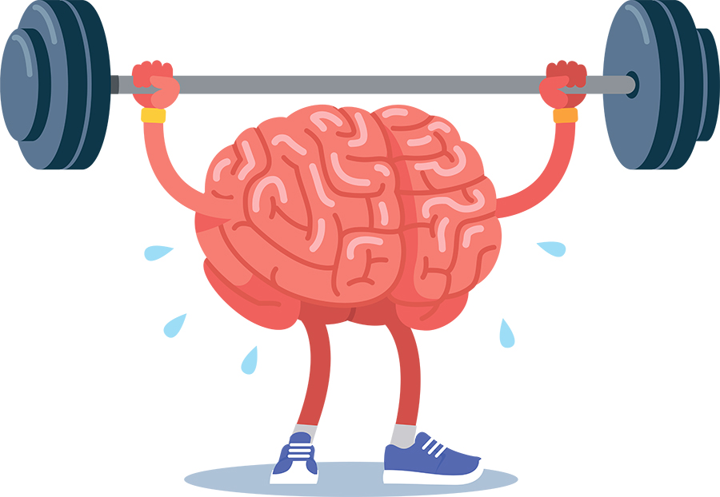
* GENERAL BENEFITS OF SPORTS *
Increase strength and stamina.
Better body shape.
They encourages us to give best every time.
Increase concentration.
Boost confidence.
They build leadership and team skills.
Make us happy.
Reduce several health risks.

Slide 15


* WHAT DO WE (STUDENT) PLAY ? *
We children usually play cricket, football, volleyball, chess, basketball and many more.

Slide 16
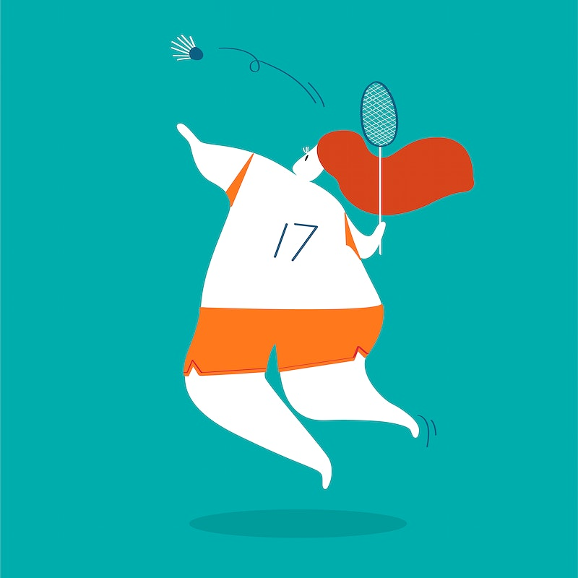
* HOW DO WE GET BENEFITS FROM THESE GAMES ? *
It helps in academic and also icrease our understanding level.
It increase our self esteem.
Help us to keep our waistline trim.
Increase team spirit.
Trust on each other when we play team games.

Slide 17

* CONCLUSION *
Sport help us a lot in maintaining our health as well as our personality.
Sport develop an an overall attitude for facing challenges in life.
So we must play each day no matter which game we play but, we must play.

Slide 18

MADE BY : RICHA
THANKYOU

